Slide 1

Learning Across Borders:
Understanding the “Good” Learners in Refugee and Migrant Population
Phd Candidate: Arsenia Anagnou
University of Alicante, Spain
July,2025

Slide 2
Introduction
Key Challenges in Multicultural Education and the Need for Inclusion
Language Barriers: Poor understanding of the instructional language hinders communication and learning.
Psychological Trauma & Forced Migration: Emotional trauma from conflict and forced migration affects concentration and participation in class.
Interrupted Schooling: Breaks in formal education led to skewed academic histories.
Cultural Misalignment: Different social norms, values, and behaviors may result in misunderstanding and exclusion.
Lack of Support Networks: Absence of academic, emotional, and familial support impedes adjustment.
Bias and Social Exclusion: Biases and stereotypes often result in marginalization, bullying, and limited opportunities.
Importance of understanding what makes a "good learner" in this context
Grounded in second language acquisition research
(European Commission, 2024; Lightbown & Spada, 2013; Ortega, 2009; Papazian-Zohrabian, 2018)

Slide 3
Aim of the study
Importance of understanding what makes a "good learner“:
Individualized Support: Understanding key learner characteristics helps teachers develop effective strategies that respond to the unique needs of migrant and refugee students.
Facilitating Equity: It avoids judgments of "ability" or "motivation" being clouded by language, trauma, or cultural difference.
Empowerment: Naming strengths like resilience, flexibility, and goal-setting facilitates positive identity and motivation.
Responsive Practice: Shifting attention from deficits (what learners lack) to assets (what they have), toward more inclusive classrooms.
Better Results: Teacher's awareness of students' strengths and needs provides educational and social results
(Baak, 2021; European Commission, 2024).

Slide 4
Learners’ Traits in Refugee and Migrant Context
Personal & Psychological
2. Cognitive Abilities
“Learners bring different cognitive resources that shape how they learn a second language.” (Ortega, 2009)
3. Social Skills
Interaction is essential for second language development. (Lightbown & Spada, 2013)
4. Behavioral & Contextual
“Effective learners actively use the input and seek opportunities to interact.” (Ortega, 2009)
“Motivation plays a crucial role in sustaining learning in the face of hardship.” (Lightbown & Spada, 2013)

Slide 5
1. Personal and Psychological Strengths
Traits that help refugee and migrant learners overcome adversity and stay focused on learning.
Motivation
Often driven by the desire to build a better future, adapt to a new culture, or support family.
Patience & Persistence
Key in coping with interrupted education, trauma, or language barriers.
(Lightbown & Spada, 2013)

Slide 6
1. Personal and Psychological Strengths
Goals
Many refugee/migrant learners set strong personal or academic goals (e.g., gain qualifications, learn the host country's language, or enter the workforce).
Age
Impact adaptability and prior learning experience. Young learners may adapt faster linguistically; older learners may face more adjustment difficulties but may have clearer goals.
(Lightbown & Spada, 2013)

Slide 7
2. Cognitive and Learning Capacities
Capabilities that influence how well refugee/migrant learners process and retain new information.
Cognitive Skills
These vary widely depending on previous education, trauma exposure, and current support systems.
Learning Aptitudes
Refugee/migrant learners often demonstrate adaptability, problem-solving, and multilingual skills due to life experience.
(Ortega, 2009)

Slide 8
3. Social and Communication Abilities
Critical for navigating a new cultural and educational environment.
Communicative Abilities
Learning a new language is often a major focus. Strong social engagement and willingness to communicate are key traits of good learners in this context.
(Lightbown & Spada, 2013)

Slide 9
4. Engagement and Environmental Factors
Behavioral traits and external conditions that impact learning.
Active Participation & Involvement
Learners who engage in classroom discussions, community programs, or peer groups tend to thrive.
Opportunities (Contextual Factor)
Access to education, language support, safe environments, and inclusive schools are crucial. A good learner takes advantage of these when available.
(Ortega, 2009)

Slide 10
Discussion
Refugee and migrant learners may demonstrate strong traits such as motivation, persistence, and adaptability, these characteristics are significantly shaped by external factors, including:
Social and Educational
Stereotypes
Preconceived notions about ability, behavior, or background can influence teacher expectations, peer relationships, and self-esteem, often limiting learner potential.

Slide 11
DISCUSSION
Stereotypes can act as a barrier to equitable treatment, affecting classroom interactions and learner identity. (Papazian-Zohrabian,2018)
Learning Environment
The quality of the school setting — including inclusion practices, language support, and cultural sensitivity — plays a crucial role in whether these learners thrive.
School context is pivotal in shaping refugee learners' academic engagement and resilience.(Baak, 2021)
Understanding that learner traits do not exist in isolation, but are influenced by broader social, cultural, and institutional dynamics, is essential for inclusive education.

Slide 12
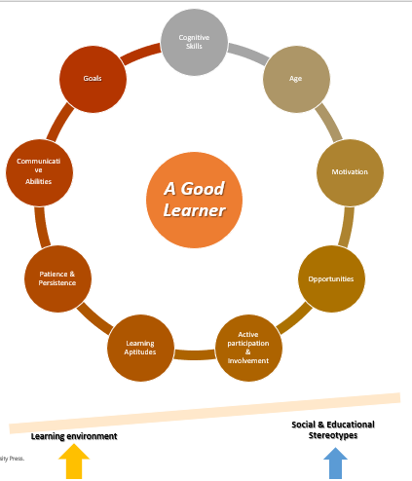
Conclusion
Understanding that learners’ traits do not exist in isolation, but are influenced by broader social, cultural, and institutional dynamics, is essential for inclusive, active and effective educational process.

Slide 13
REFERENCES
Baak, M., et al. (2021). Why school context matters in refugee education. Educational Research for Policy and Practice, 22(2), 123–137. https://doi.org/10.1007/s10671-023-09338-3
European Commission. (2024). Refugee and migrant integration into education and training. Retrieved from https://education.ec.europa.eu/focus-topics/improving-quality/inclusive-education/migrants-and-refugees
Lightbown, P. M., & Spada, N. (2013). How languages are learned (4th Ed.). Oxford: Oxford University Press.
Ortega, L. (2009). Understanding second language acquisition. New York: Routledge.
Papazian-Zohrabian, G., et al. (2018). Pedagogical challenges in integrating refugee students in the Global North: A literature review. PROSPECTS, 48(3), 269–285. https://doi.org/10.1007/s11125-022-09632-7
Simply Info (20th March 2017) What is collaborative learning | Collaborative learning strategies. (Duration 3:46) SimplyInfo.net: https://www.youtube.com/watch?v=7gWS4mxM1Qc
Wells, G. (2007). Who we become depends on the company we keep and on what we do and say together. International Journal of Educational Research, 46(1-2), 100-103.

